Slide 1

International Solid Waste Association (ISWA) Webinar
March 31, 2015

Slide 2
Agenda
Overview of the mechanism
3
Project selection criteria
7
How the auction will work
9
Delivering the put option through a World Bank bond
12
Next steps: How to participate
13

Slide 3

Objectives and Scope
Pilots an innovative climate finance mechanism that uses auctions to maximize impact of funds
Provides incentive for private sector investment in projects that reduce greenhouse gas emissions
Disburses resources against independently verified emission reductions
Initially targets methane
$100m target capitalization – learning a key objective for scaling-up or replication for use with other pollutants or other results

Slide 4
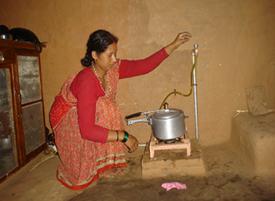
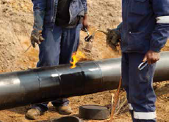
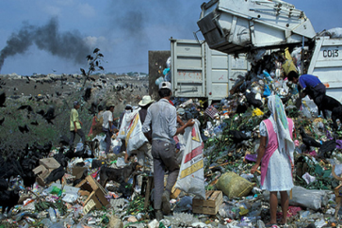
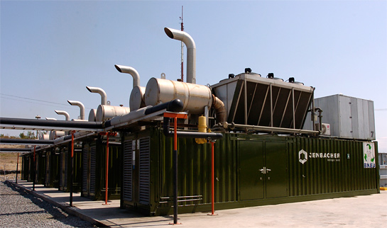
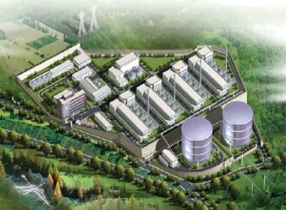
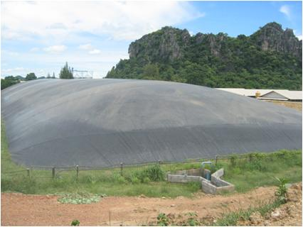
Initial target: Methane mitigation projects
Sample Supported Projects
Why Methane
Methane is a highly potent greenhouse gas, 25 times that of carbon dioxide (CO₂)
Concerted action in methane sectors alone could lessen warming by 0.3°C by 2050
Methane aids in the formation of urban "smog" that is toxic to plants and crops and damaging to lungs, causing asthma and even heart attacks
Captured methane can be burned for cooking or electricity generation
~1,200 projects, capable of reducing ~850 Mt CO₂e until 2020, were identified as stranded – the initial target of the PAF
Household biogas
Oil & gas
Landfill gas
Landfill gas to energy
Coal mine methane
Animal waste capture

Slide 5

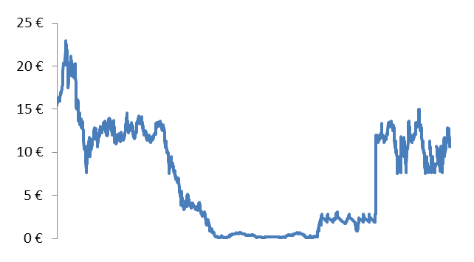
The PAF will offer a price guarantee by using the financial equivalent of a put option
Market prices collapsed, stranding projects with no incentive to reduce emissions
The PAF will pilot using “put options” to guarantee a floor price
Put options give the right, but not the obligation to sell at the guarantee price
The auction result sets the guarantee price level
Auctioning ensures that the least-cost climate mitigation activities are selected
Auction winners purchase the price guarantee (pay put premium)
Historic and hypothetical emission reduction prices*
“Put option” price guarantee
2008
2010
2012
2014
2016
2018
2020
Price guarantee exercised
Price guarantee not exercised
*Prices after 2014 are hypothetical and for explanatory purposes only.

Slide 6
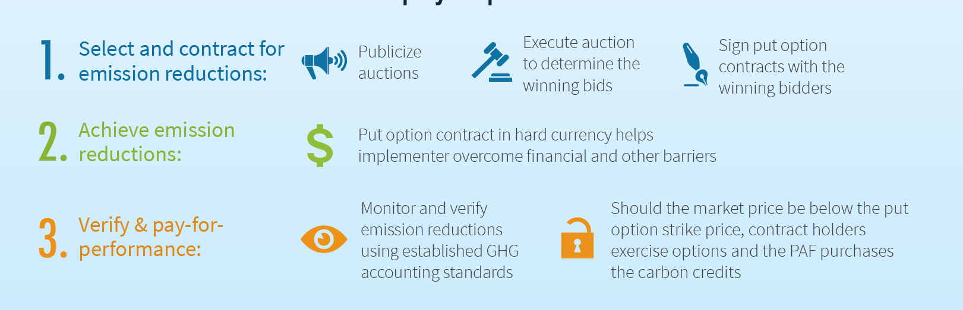
How it works: Step-by-step
Notes:
This Methane Climate Finance Pilot works as follows:
Funds are pooled by donors who agree on the sectors, developing countries and technologies they want to target with the pilot.
For each auction round, the fund publicizes the eligibility criteria that projects must meet for their credits to be accepted against the put options. The fund then organizes an auction where project owners are invited to bid the price at which they will sell their emission reductions. We’ll come back in detail to the auction soon.
The winning bids are selected and purchase the put option contract. This multi-year contract in hard currency helps these projects maintain operation and / or overcome the barriers for implementation, as the case may be. These put options are also tradable, meaning that the owners can choose at any time to sell them to another project owner. Tradability is very important to help put option owners mitigate project risks.
Projects are implemented and on a yearly basis, the emission reductions achieved are independently verified.
The fund makes payments to project owners for these emission reductions – unless the project owners find a buyer for their carbon at a better price.

Slide 7
Project selection criteria
The PAF has published a list of eligibility criteria for emission reductions
Sectors
Environmental, Health & Safety
The first auction will target methane
Waste, waste water and agricultural waste projects
Other (including non-methane) sectors in future auctions
To review environmental, health and safety risks of the project an audit against key performance criteria will be required just prior to put option redemption
Audit to be performed by a CDM DOE (could be the same that performs CDM verification)
The cost of the EHS inspection is to be borne by the option owner
The EHS audit will be required with each put option redemption (i.e., annually)
The EHS criteria are being worded so as to be readily answered, in order to achieve a pass or fail result.
Countries
Most countries are eligible in the 1st auction
Country-specific future auctions possible
Emission reductions
First auction will accept only CDM credits – thus projects will have to be CDM registered
Credits must be “fresh”, issued post auction
Future auctions may be open to other standards

Slide 8
Eligible generation and issuance dates
DATES MAY VARY
SEE ELIGIBILITY RULES
September 15, 2014*
September 30, 2016
Auction Date
Redemption 1 –
September 2016
September 30, 2017
Redemption 2 –
September 2017
September 30, 2018
Redemption 3 –
September 2018
September 30, 2019
Auction Date
Redemption 4 –
September 2019
September, 30 2020
Redemption 5 –
September 2020
Key
Accepted Issuance Dates
Accepted Monitoring Period Dates
Auction Date
Redemption Period Start
*
Announcement of the PAF on September 15, 2014

Slide 9
How the auction will work (1 of 3): pre-auction steps
PAF engaged in global marketing campaign to ensure that a diverse set of firms are made aware
PAF announced transparent and objective criteria for eligible emission reductions
The PAF announces the option premium for all put options ($0.30 per ton) – this is the amount winners will need to pay up-front to purchase the option; losers owe nothing
Bidders announce their intention to participate, place a fully refundable deposit in order to indicate the maximum [value/volume] they are willing to purchase in the auction (e.g., 20%).
Bidders undergo World Bank Integrity Due Diligence screening
Training for bidders on the auction rules and online platform
The PAF sets a reserve price which is the auction starting price

Slide 10
How the auction will work (2 of 3): descending clock auction
Bidders identify the quantity of put options they are willing to buy at the starting price; if the aggregate demand for put options is greater than the supply (the auction budget) than there is a new round with a lower price; if a participant is unwilling to buy at the new round’s announced price they drop out of the auction completely
A second round starts and the PAF sets a lower price and bidders identify the quantity of put options they are willing to buy at that price; if aggregate demand is greater than supply than a new round is declared with a lower price
Auction rounds continue with additional bidders dropping out until a round where aggregate demand is less than or equal to supply – this becomes the clearing price and all bidders left standing; this is the uniform put option strike price

Slide 11
How the auction will work (3 of 3): descending clock auction
Price
(per ton)
Fixed Supply
(auction budget)
Demand
(for options)
$7
$7: Starting price – Round #1
$6
$6: Round #2
Descending
price clock
FOR EXAMPLE ONLY
AUCTION RESULTS WILL VARY
$5
$5: Round #3
$4.50: Round #4
$4
$4: Winning Price – Round #5
$3
$2
$1
$25 million*
Quantity
($ millions)
* Auction budget will actually increase as bid decrements tick lower (b/c more options get sold). In this example the initial $25m budget will generate ~$3.5m in premium back into the auction. The use of premiums to increase the size of the auction will happen in real time in the online platform.

Slide 12
Delivering the put option through a World Bank bond
Advantages
Key Terms of the Putable Bond
A putable bond provides the financial equivalent of a put option
Speed to market
Ease of use by private sector
Enhanced tradability
Zero Coupon
Bond Issue Price – is the equivalent of the premium
Bond holder receives payment of strike price if redeems eligible ERs
Maturities correspond to the redemption dates

Slide 13

How to participate: Next steps in calendar view
February
March
April
May
June
Consultations /outreach to bidders
Eligibility criteria announced
Auction date announced
Bidder application due
APPROXIMATE
(official dates to be announced)
Bid deposits due
Username/passwords distributed; trainings
Mock auction
AUCTION DATE

Slide 14
I am interested, what should I do now to prepare?
Identify source of CERs to be issued after auction date in methane sectors of waste, waste water and agricultural waste and decide on bidding strategy (e.g., number of put options desired, lowest acceptable price)
Review specific eligibility criteria posted on PAF website
Prepare to pay refundable bid deposit
If auction winner, prepare to pay premium to purchase put options
CDM projects owners might be contacted by carbon aggregators and consultants interested in participating in PAF auctions
Look for emails from PAF Secretariat and check the PAF website for deadlines – www.pilotauctionfacility.org

Slide 15
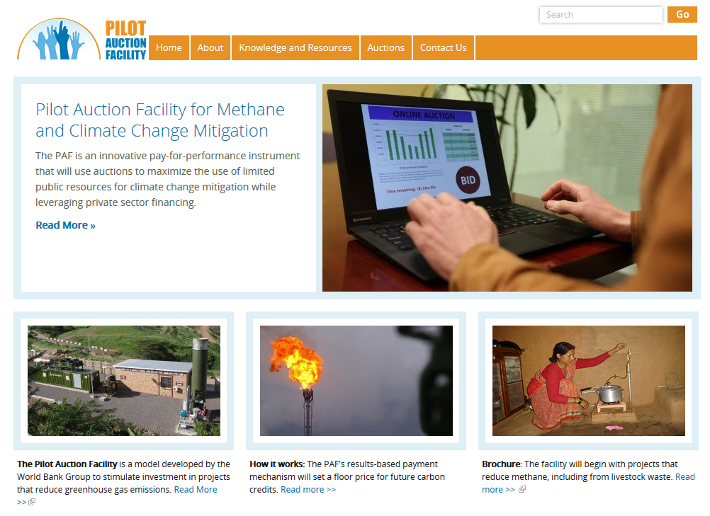
Thank you
For more information visit: www.pilotauctionfacility.org

