Slide 1

Third Auction Briefing
October 13, 2016
Berlin, Germany

Slide 2
Disclaimer
THE FOLLOWING IS A SUMMARY OF THE WORLD BANK’S PROPOSED PLAN TO ISSUE PILOT AUCTION FACILITY EMISSION REDUCTIONS NOTES (“PAFERNS”). IT IS NOT AN OFFER TO SELL PAFERNS OR AN INVITATION TO OFFER TO BUY PAFERNS. THIS SUMMARY IS SEPARATE FROM, AND SHOULD NOT BE READ IN COMBINATION WITH, ANY FUTURE OFFER OR SALE OF PAFERNS, WHICH WILL BE MADE IN COMPLIANCE WITH APPLICABLE LAWS AND UNDER ENTIRELY SEPARATE LEGAL DOCUMENTATION AND OFFERING MATERIALS. THIS SUMMARY IS VERY HIGH LEVEL FOR SIMPLICITY AND LEAVES OUT MATERIAL INFORMATION AND THE LEGAL DOCUMENTATION THAT IS EXPECTED TO GOVERN THE PAFERNS. FURTHER, IT IS CURRENT ONLY AS OF THE DATE OF POSTING TO THIS WEBSITE AND IS LIKELY TO BECOME OUTDATED AS THE PAFERNS LEGAL DOCUMENTATION IS DEVELOPED. THE STRUCTURE, TIMING AND MECHANICS OF THE ACTUAL PAFERNS, IF AND WHEN THEY ARE ISSUED, ARE SUBJECT TO CHANGE. POTENTIAL INVESTORS MUST OBTAIN A COPY OF THE COMPLETE LEGAL DOCUMENTATION PURSUANT TO WHICH THE PAFERNS WILL BE ISSUED, INCLUDING THE WORLD BANK’S MAY 2008 PROSPECTUS RELATING TO ITS GLOBAL DEBT ISSUANCE FACILITY AND THE FINAL TERMS FOR ANY ISSUANCE OF PAFERNS. POTENTIAL INVESTORS SHOULD NOT RELY ON THIS SUMMARY. BEFORE MAKING ANY INVESTMENT DECISION, POTENTIAL INVESTORS MUST REVIEW THE COMPLETE LEGAL DOCUMENTATION (ONCE AVAILABLE).

Slide 3
Origins of the PAF
The Pilot Auction Facility (PAF) is an innovative climate finance model hosted by the World Bank to stimulate private investment in projects that reduce greenhouse gas emissions
Carbon credit prices collapsed, stranding projects with no incentive to reduce emissions
The PAF was developed after the Methane Finance Study Group, an international group of experts convened at the request of the G8, recommended the creation of a methane abatement facility that would auction put options to guarantee a price floor on independently verified emission reductions
The PAF is backed by Contributors (United States, Germany, Sweden, Switzerland) which have contributed $53 million in total resources
To date, the PAF has hosted two auctions (July 2015 and May 2016) allocating over $40 million in climate finance for methane emission reductions

Slide 4
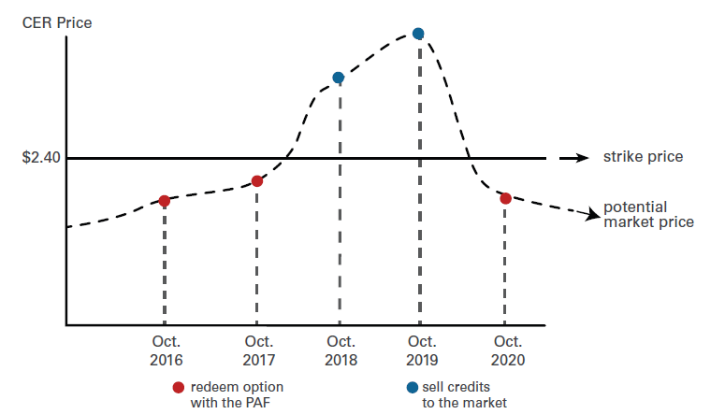
The PAF Offers a Price Guarantee for Carbon Credits
The PAF sells “put options” that guarantee a price for carbon credits
The put options give the owner the right, but not the obligation, to sell their carbon credits to the PAF at a predetermined price in the future (the “strike price”)

Slide 5

The PAF Uses Auctions to Sell Put Options
The PAF holds auctions in which bidders compete to purchase put options
The third auction will determine the “strike price,” which is the price offered to option owners in the future for eligible carbon credits
Auction winners will purchase put options by paying an “option premium” price
The PAF will only pay option owners for independently verified carbon credits
Auctioning ensures that least-cost climate mitigation activities are selected

Slide 6
Video: Introduction to PAF Mechanism
Watch Videos

Slide 7
Third Auction Overview
The third auction will focus on mitigation of nitrous oxide, produced by industrial nitric acid and caprolactam plants (not adipic acid)
N2O is a highly potent greenhouse gas with a global warming potential approximately 300 times that of CO2
To be eligible for payment the carbon credits must meet a set of eligibility criteria:
Certification standards
Mitigation activities (methodologies)
Countries
Generation and issuance period
Environmental, Health and Safety Criteria

Slide 8
Third Auction Parameters
TO BE CONFIRMED IN AUCTION RULES (PUBLISHED SEPARATELY)
Auction Format: Reverse Descending Clock in Two Segments
    Segment New Abatement Projects (aka “New Segment”)
    Segment Open to All Abatement Projects (aka “Open Segment”)
Auction Budget:
    New Segment: $6m
    New Segment + Open Segment: $12m
Fixed Premium Price: $0.30/ton
Auction Total Supply (budget ÷ strike):
          New Segment: 1,000,000 tons
          Open Segment: 1,200,000 tons to 2,400,000 tons (depending on result of New Segment)
Strike Starting Price:
          New Segment: $6.00/ton
          Open Segment: $5.00/ton
Refundable Deposit: $0.06/ton
Minimum Bid: 100,000 tons
Maximum Bid: 2,000,000 tons

Slide 9
Third Auction: Eligibility Criteria (1 of 4)
All eligibility criteria will stay fixed over the life of put options issued from the third auction
Future PAF auctions may have different criteria
  1. Certification standards
  2. Methodologies
All emission reductions must be Certified Emission Reductions (CERs) or a Verified Carbon Standard (VCS) Verified Carbon Unit (VCU)
Emission reductions must not be subject to purchase agreement contract with a third-party
The list of eligible methodologies is found on the PAF website, most methodologies that correspond to the abatement of N2O from nitric acid are eligible
Methodologies related to adipic acid are excluded
If a project uses more than one methodology to account for emission reductions, all need to be on the eligible list

Slide 10
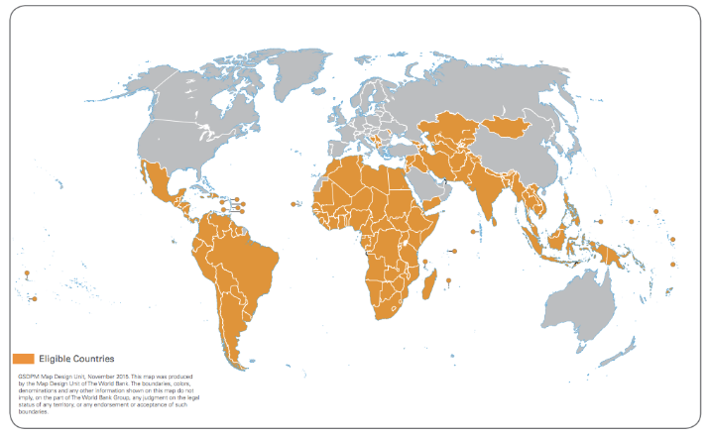
Third Auction: Eligibility Criteria (2 of 4)
  3. Eligible Countries
The list of eligible countries is found on the PAF website
  4. Generation and issuance period
Winners will receive a Bermuda-style put option, which must be exercised by the final maturity date, but may be exercised at any of three earlier optional redemption dates
No restrictions on the quantity of ERs that may be redeemed at each redemption date
After the maturity date, all of the put options expire
Optional redemption dates |  |  | Maturity
Nov. 29, 2017 | Nov. 29, 2018 | Nov. 27, 2019 | Nov. 30, 2020

Slide 11
Third Auction: Eligibility Criteria (3 of 4)
  5. Environmental, Heath & Safety and Social Criteria
The EHS criteria for the third auction is found on the PAF website
Emission reductions must originate from a CDM or VCS project that has received a positive environmental, health & safety and social (EHS) report from a CDM accredited Designated Operational Entity (DOE)
The EHS criteria is designed as a checklist to enable the DOE to provide a binary (positive / negative) result
The inspection report will incorporate input from the host site and project staff as well as representatives of nearby/affected communities and responsible local government agencies, as appropriate
The cost of the EHS inspection is to be borne by the option owner

Slide 12
Third Auction: Eligibility Criteria (4 of 4)
The PAF will issue PAFERNs specific to two auction segments
Bidders will be able to bid in both segments
  New Segment
  Open Segment
Price guarantee allocated can only be redeemed with emission reductions from new abatement projects that purchase abatement equipment for the first time after the auction date.
Emission reductions must be sourced from a new abatement project that has not purchased abatement technology before the auction date, meaning that the date on which the project first purchases a secondary or tertiary catalyst or abatement equipment at the existing host site must be at the earliest on the auction date.
Price guarantees may be redeemed with any eligible emission reductions. N2O abatement projects can be existing at the time of the auction or result from investments post-auction.
Slide updated upon release of Bidder Application Package – October 26, 2016

Slide 13
Announcement of Other Elements for Third Auction
TO BE CONFIRMED IN AUCTION RULES (PUBLISHED SEPARATELY)
  Other Elements
The auction budget is a total of $12m across both segments
  The budget for New Segment is $6m. Any unspent budget from New Segment will be added to the budget of the Open Segment. The Segments are scheduled to run consecutively on the same day, although upon the conclusion of the New Segment, the Open Segment may be rescheduled to another day by the Secretariat for lack of time or other reasons
Each option will require 2,500 eligible homogeneous ERs (from same project, vintage or monitoring period) at redemption, and will be sold to auction winners for $750 (i.e., $0.30 per ER).
1 Bid Unit = 10,000 ERs; divided into 4 x 2,500 Lots
Bidders must post a refundable deposit of $0.06 per ER that they wish to redeem (i.e., for each 2,500 ER Lot $150 must be deposited
A DOE will have to certify, in a separate schedule, that an ER is eligible for payment with PAFERNs won in Segment A was a result of an abatement project that was operational after the auction date.
To become qualified to bid, firms will undergo an integrity due diligence screening
The auction clearing prices and the winners will be made public on the PAF website

Slide 14
Both segments will be descending clock auctions
Price
(per ton)
Fixed Supply
(auction budget)
Demand
(for options)
$7
$7: Starting price – Round #1
$6
$6: Round #2
Descending
price clock
FOR EXAMPLE ONLY
AUCTION RESULTS WILL VARY
$5
$5: Round #3
$4.50: Round #4
$4
$4: Winning Price – Round #5
$3
$2
$1
$6 million*
Quantity
($ millions)

Slide 15
Delivering the put option through a World Bank bond
  Key Terms of puttable bond
  Process Steps
Pilot Auction Facility Emission Reductions Notes: PAFERNs
Zero Coupon Bond
Bond Final Redemption Amount: determined by auction
Bond Issue Price (Premium): $0.30 per ton
Bond holder receives payment of strike price for eligible emission reductions at the point of redemption
Auction winners will purchase bonds via World Bank’s Global Agent – Citi
Bonds will be delivered in the form of Definitive Registered Certificates by Citi
Citi will keep a registry of the Noteholders
Winners will not be required to open a custodian account
The World Bank will hold a specific webinar to answer questions about the PAFERNs, after the application package has been made public

Slide 16
How to Participate: Next Steps & Dates
Eligibility criteria announced
September 21, 2016
Application package released/auction date announced
October 26, 2016
Bidder application due
Monday, November 28, 2016
Bid deposits due
January 3, 2017
Username/passwords distributed; trainings
First week of January
Mock auction
First week of January
AUCTION DATE
Tuesday, January 10, 2017

Slide 17
I am interested. What should I do now to prepare?
Request Application Package by following this link and following instructions
  https://www.pilotauctionfacility.org/content/request-bidder-application-package-and-draft-final-terms
Determine to participate in New or Open Segment -- or both
Identify source of ERs to be generated after auction date and decide on bidding strategy (e.g., number of put options desired, lowest acceptable price)
Review specific eligibility criteria posted on PAF website
Prepare to pay refundable bid deposit
If auction winner, prepare to pay premium to purchase put options
Projects owners might be contacted by carbon aggregators and consultants interested in participating in PAF auctions

Slide 18
More Resources
Third auction eligibility criteria including specific methodologies and countries – Link
Third auction EHS criteria – Link
Questions and answers – Link
First auction results – Link / Second auction results – Link
Lessons learned from the first auction – Link
World Bank puttable bonds: First auction – Link / Second auction – Link
Summary of the day’s bidding in the 1st auction – Link

Slide 19







Thank you
For more information visit: www.pilotauctionfacility.org
Contributors
PAF Vendors / Agents / Partners
Notes:
Thank you and please feel free to ask us questions

