Slide 1
Bidder Q&A Webinar
April 8, 2015

Slide 2
Agenda
Eligibility criteria for the first auction
3
Reverse auction
7
Delivering the put option through a World Bank bond
8
Next steps: How to participate
9

Slide 3
Eligibility Criteria for First Auction (1 of 3)
All eligibility criteria will stay fixed over the life of put options issued from the first auction
Future PAF auctions may have different criteria
A. Eligible Emission Reductions
B. Eligible Methodologies
All emission reductions must be Certified Emission Reductions (CERs)
CERs must not be subject to purchase agreement contract with a third-party
The list of eligible methodologies is found on the PAF website, most methodologies that correspond to solid waste, waste water and agricultural waste are eligible
If a project uses more than one methodology to account for emission reductions, just one needs to be on the eligible list
C. Eligible Countries
The list of eligible countries is found on the PAF website
For multi-country PoAs, all countries must be on the eligible list
Notes:
Chinese CERs will not be eligible for redemption with put options auctioned in the PAF’s first auction. This decision was taken to avoid potential overlap/conflict with the domestic offset mechanism of the Chinese ETS pilots and soon national ETS, which provides a source of demand for credits from methane projects in China. The decision of which countries and sectors to target will be made on an auction round by auction round basis.

Slide 4
Eligibility Criteria for First Auction (2 of 3)
FOR ILLUSTRATION
SEE ELIGIBILITY RULES
September 15, 2014*
September 30, 2016
Auction Date
Redemption 1 –
September 2016
September 30, 2017
Redemption 2 –
September 2017
September 30, 2018
Redemption 3 –
September 2018
September 30, 2019
Auction Date
Redemption 4 –
September 2019
September, 30 2020
Redemption 5 –
September 2020
Key
Accepted Issuance Dates
Accepted Monitoring Period Dates
Auction Date
Redemption Period Start
*
Announcement of the PAF on September 15, 2014

Slide 5
Eligibility Criteria for First Auction (3 of 3)
D. Environmental, Heath & Safety and Social Criteria
The EHS criteria for the first auction is found on the PAF Website
Emission reductions must originate from a CDM project or Program of Activities that has received a positive environmental, health & safety and social (EHS) report from an accredited Designated Operational Entity (DOE) at the time of the report which is to be dated no more than 547 days prior to the redemption date
The EHS criteria is designed as a checklist to enable the DOE to provide a binary (positive / negative) result
The inspection report will incorporate input from the host site and project staff as well as representatives of nearby/affected communities and responsible local government agencies, as appropriate
The cost of the EHS inspection is to be borne by the option owner

Slide 6
Announcement of other Elements for First Auction
Other Elements
The auction budget is $25 million
Each put option will require 2,000 CERs and will be sold to auction winners for $600 (i.e., $0.30 per CER)
Winners will be required to purchase a complete series of put options, redeemable annually for 5 years
To become qualified to bid, firms will undergo an Integrity Due Diligence screening and pay a refundable deposit (questionnaire already published)
The auction clearing strike price and the winners will be made public on the PAF webpage
To be announced on the PAF webpage and communicated to interested stakeholders in the coming weeks:
Auction date (expected auction date of June 2015)
Starting price in auction
Minimum and maximum bid amounts
Size of the refundable deposit, and deposit due date and instructions

Slide 7
How the auction will work: descending clock auction
Price
(per ton)
Fixed Supply
(auction budget)
Demand
(for options)
$7
$7: Starting price – Round #1
$6
$6: Round #2
Descending
price clock
FOR EXAMPLE ONLY
AUCTION RESULTS WILL VARY
$5
$5: Round #3
$4.50: Round #4
$4
$4: Winning Price – Round #5
$3
$2
$1
$25 million*
Quantity
($ millions)
* Auction budget will actually increase as bid decrements tick lower (b/c more options get sold). In this example the initial $25m budget will generate ~$3.5m in premium back into the auction. The use of premiums to increase the size of the auction will happen in real time in the online platform.

Slide 8
Delivering the put option through a World Bank bond
Key Terms of the Putable Bond
Process Steps
Zero Coupon
Bond Issue Price – is the equivalent of the premium (i.e., $600 for 2,000 CERs)
Bond holder receives payment of strike price if redeems eligible ERs
Maturities correspond to the put option redemption dates
Auction winners will purchase bonds via World Bank’s Global Agent -- Citi
Bonds will be issued to the auction winners through the traditional bond clearing systems (Clearstream or Euroclear)
Bonds will be purchased, held and sold through a custodian bank
World Bank will release additional information, including bond terms, ahead of the bidder registration date

Slide 9
How to participate: Next steps in calendar view
February
March
April
May
June
Consultations /outreach to bidders
Eligibility criteria announced
Auction date announced
Bidder application due
APPROXIMATE
(official dates to be announced)
Bid deposits due
Username/passwords distributed; trainings
Mock auction
AUCTION DATE

Slide 10
I am interested, what should I do now to prepare?
Identify source of CERs to be issued after auction date in methane sectors of waste, waste water and agricultural waste and decide on bidding strategy (e.g., number of put options desired, lowest acceptable price)
Review specific eligibility criteria posted on PAF website
Prepare to pay refundable bid deposit
If auction winner, prepare to pay premium to purchase put options
CDM projects owners might be contacted by carbon aggregators and consultants interested in participating in PAF auctions
Look for emails from PAF Secretariat and check the PAF website for deadlines – www.pilotauctionfacility.org

Slide 11
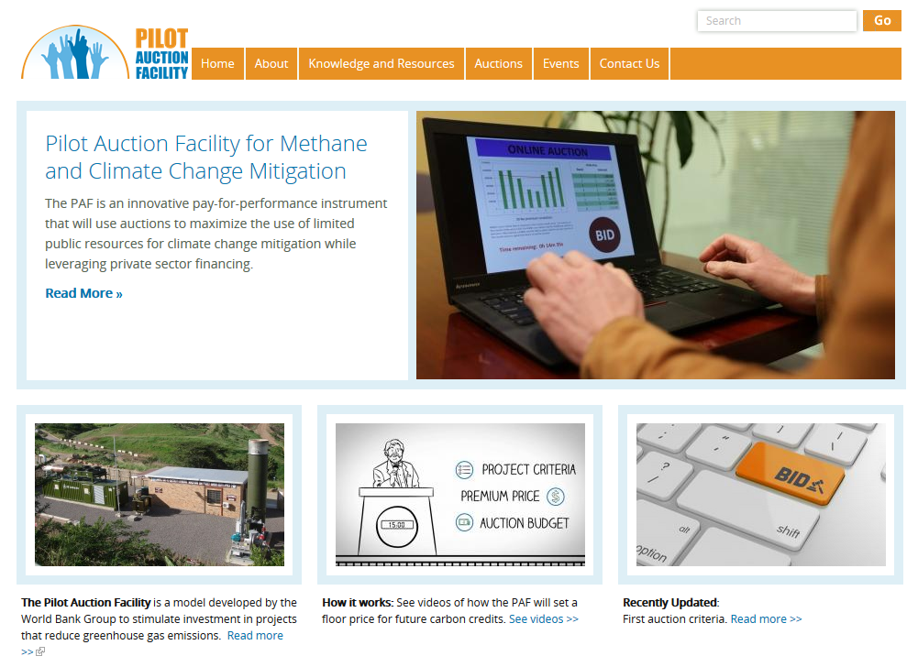
Thank you
For more information visit: www.pilotauctionfacility.org

